Slide 1

Project Presentation
KANNAN AZHAGAPPA

Slide 2
Requirement Statement
Create a React App for E-Commerce with the following features:
Sign Up
Sign In
Authentication
Secure Path
Profiles
Product Catalogue to be browsed & Add Items to Cart
Checkout Page/Summary
Image Gallery
User Signoff

Slide 3
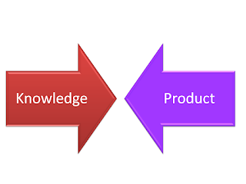
Solution Approach
Brainstorm Ideas
Think about Implementation
Identify Skillset
Identify Knowledge Gap

Slide 4
Solution Approach
Research
Develop
Re-factor & Improvise

Slide 5
Solution Approach
Structure the project in below way:
2 types of components -> Styled Components and Normal React Components
Have a Home Page
Browse Page (Using API and Local Storage)
Modal for Click action from Browse Page (Using set state using click event and passing props)
Checkout Page (Using Global State, Redux and Local Storage)
Firebase for Authentication & Storage
Split components into Containers and Pages
Compound Components
Image Gallery Component

Slide 6
Timeline
Planning (4 days)
Started on
7th Nov’20
Research (3 days)
Initial Implementation (3 days)
Re-factorisation & Improvement
(6 days)
Documentation (2 days)

Slide 7
Important Concepts Used
React
Router (Secured & Normal)
Media
Firebase
Authentication
Storage
Animation
Context
Redux
Styled Components
Global State
Hooks

Slide 8
Important Concepts Used
Data
API
JSON
Local Storage
Modular JavaScript
Of course, normal HTML,CSS and JavaScript
And responsive design, flexbox, grid layout and more…

Slide 9
Issues Faced
Getting the correct styles
Responsiveness for all the pages
Finding the right APIs
Finding the right guidance/setup requirements

Slide 10
How Did I Solve The Issues
Finding solutions online
De-bugging the code
Improvising the code
Repeat this process….

Slide 11
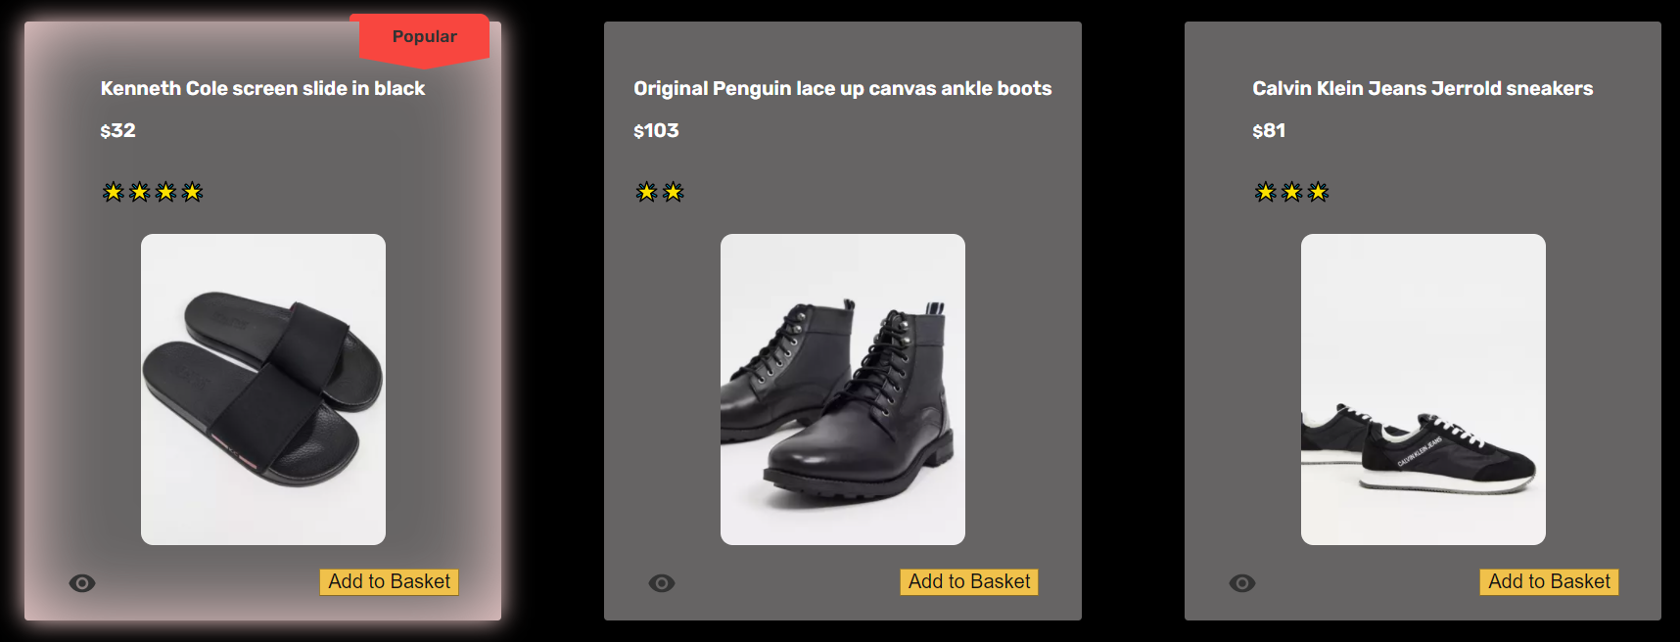
Application - Major Satisfaction
Styling for Product Catalogue

Slide 12
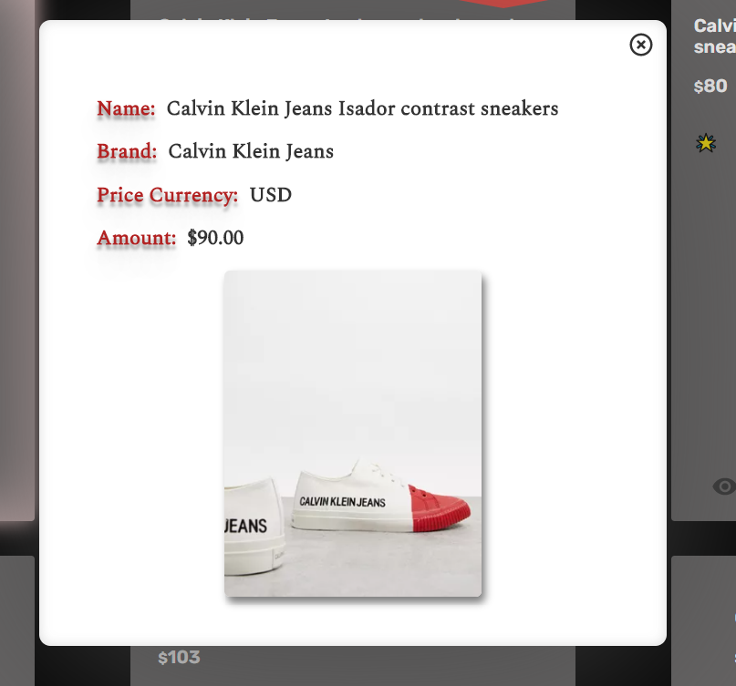
Application - Major Satisfaction
Modal

Slide 13
Walkthrough & Demo
https://github.com/KannanAzhagappa/Module2_FinalProject.git

Slide 14
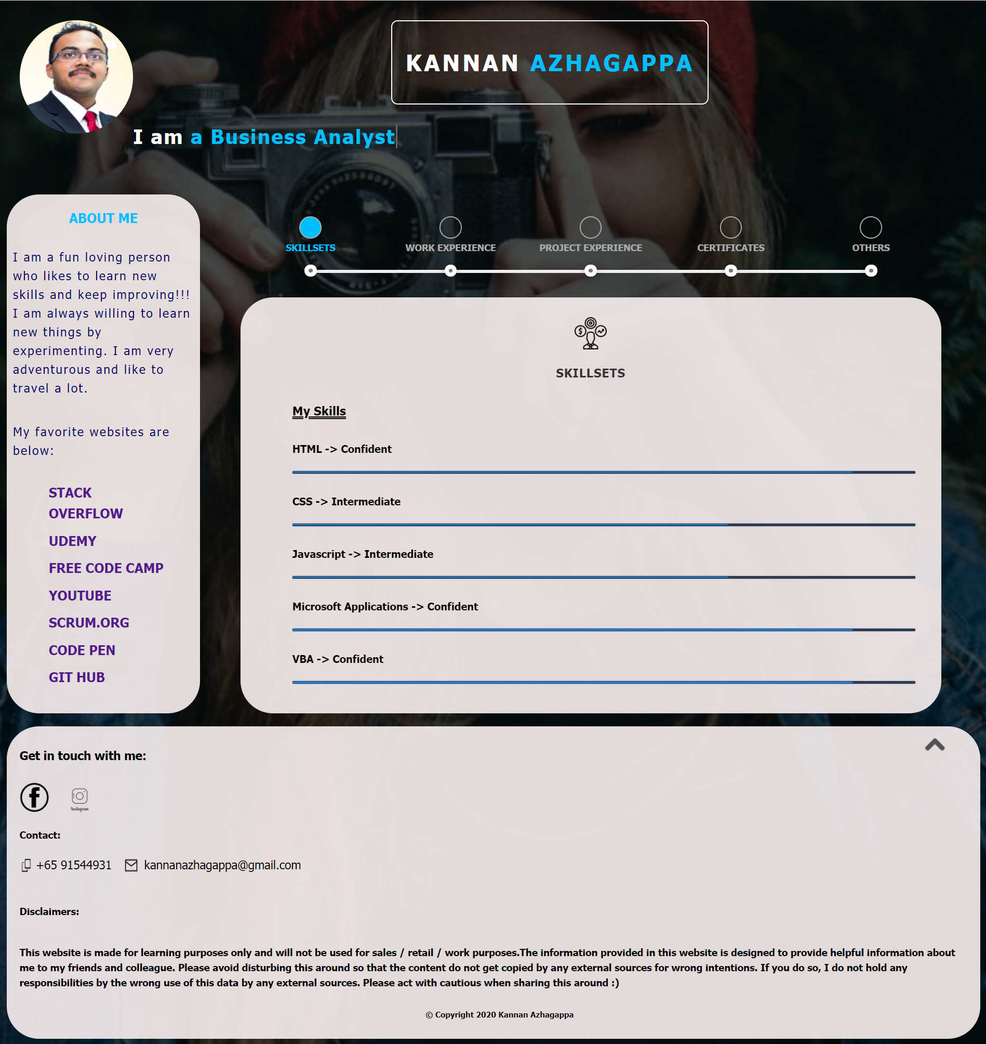
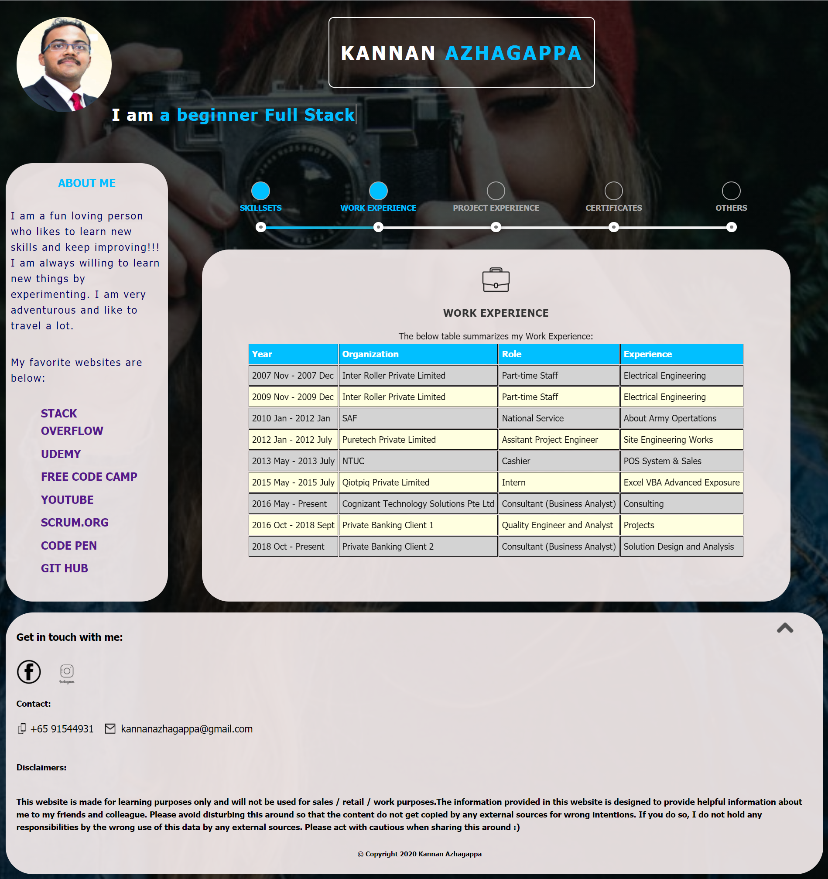
Walkthrough & Demo – Module 1

Slide 15
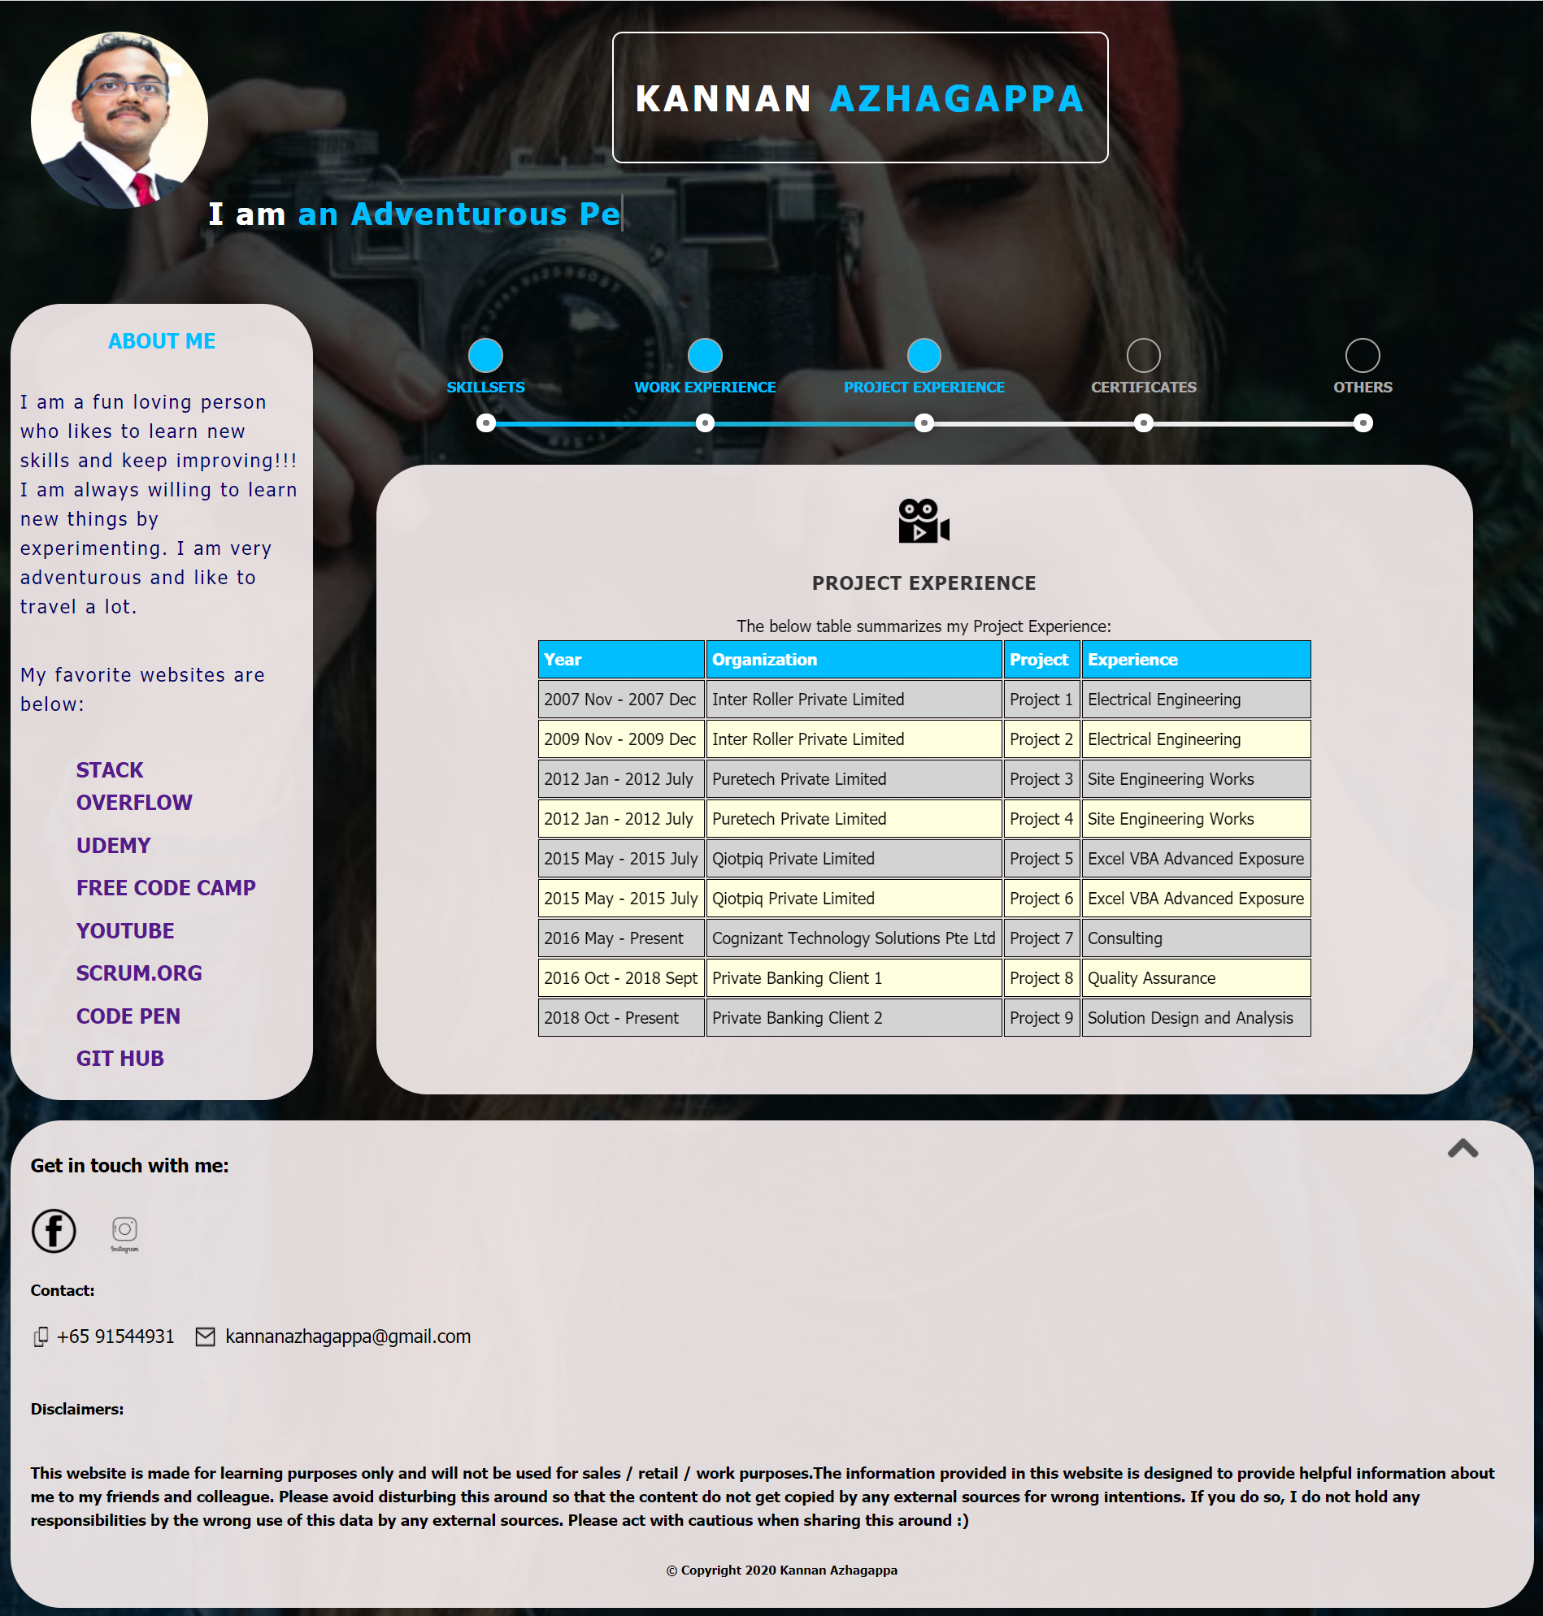
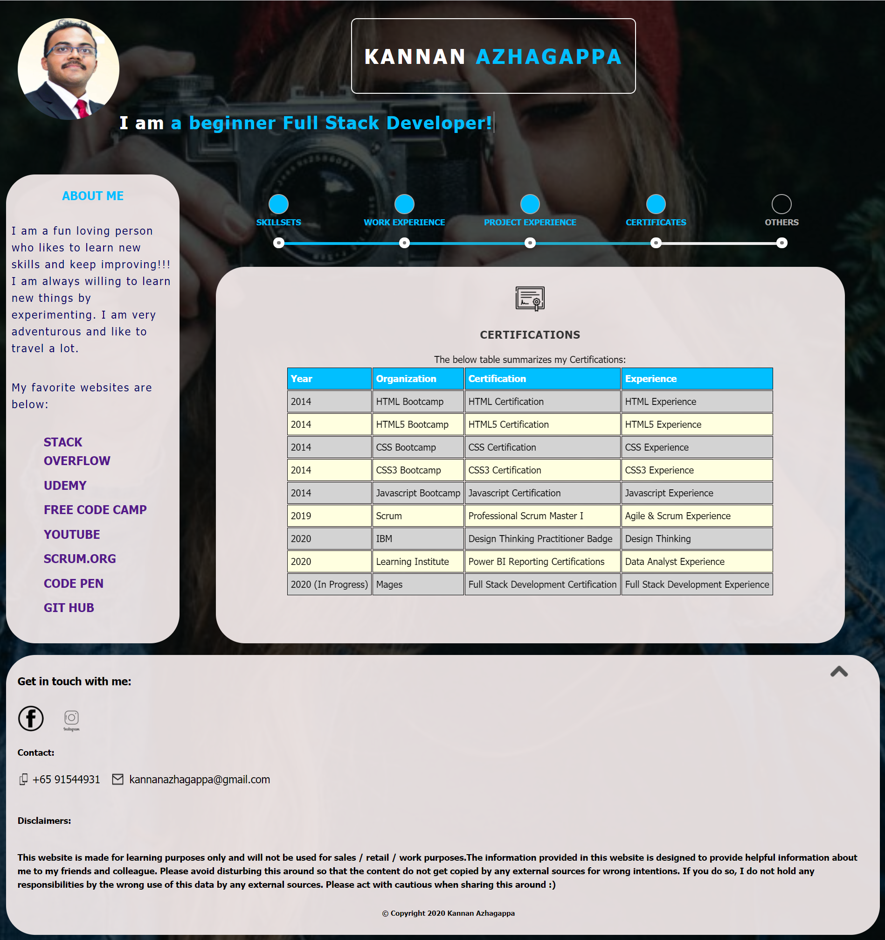
Walkthrough & Demo – Module 1

Slide 16
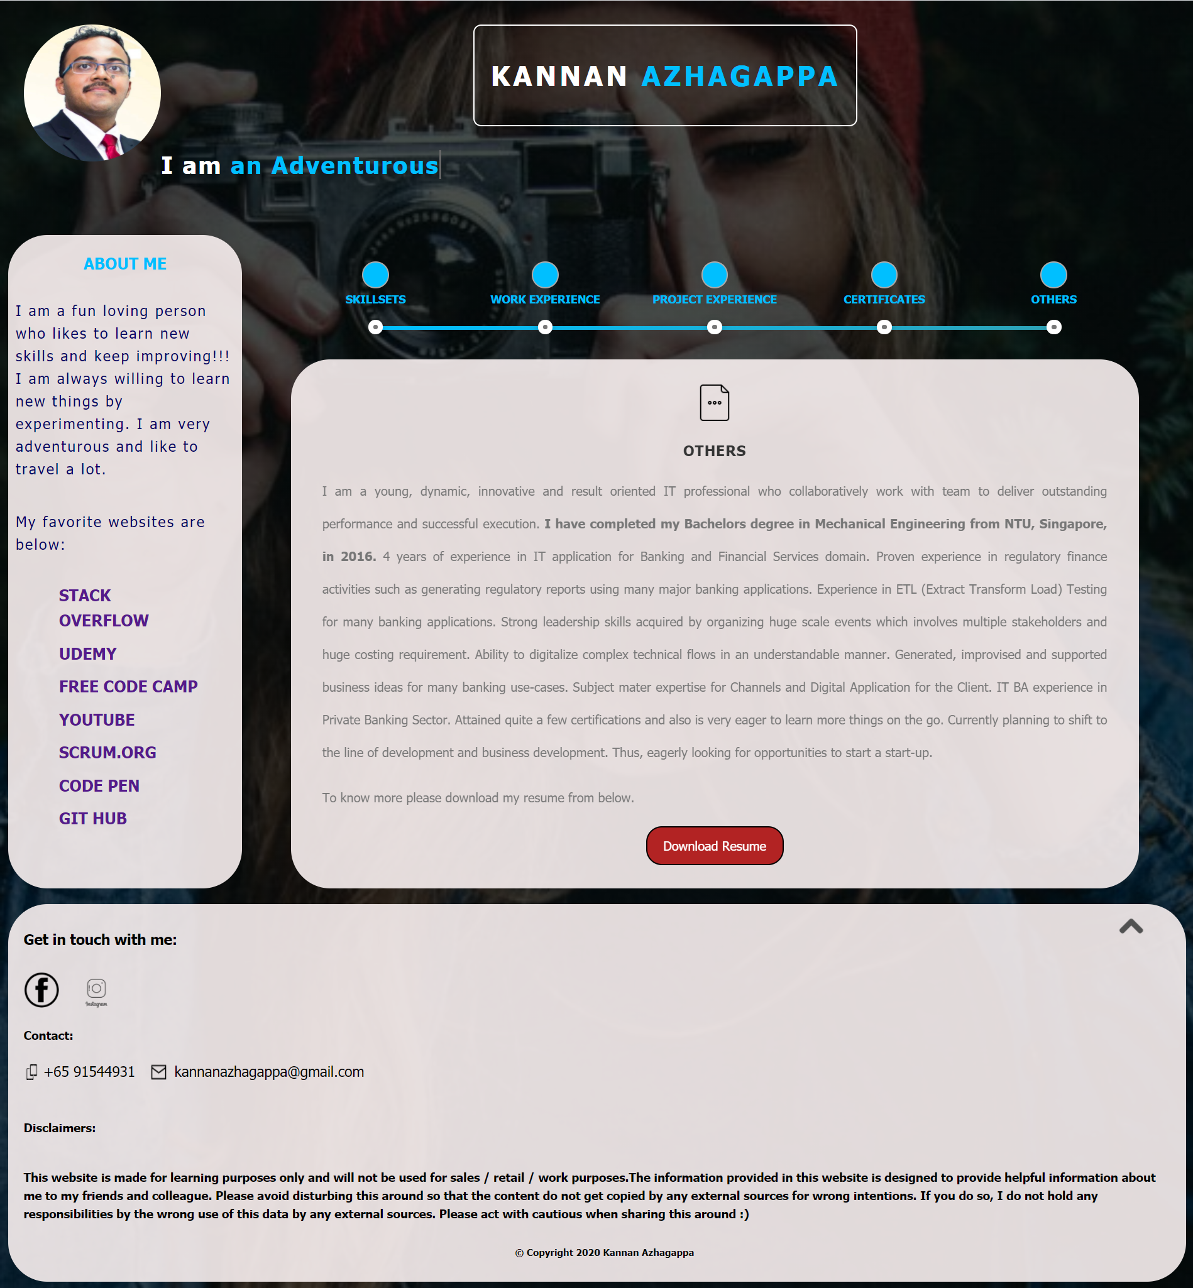
Walkthrough & Demo – Module 1

Slide 17
Possible Additional Features (Which I would like to explore & learn…)
Firebase Realtime Database
Payment Processing
Pagination
Sharing of data/materials among Users
Admin Accounts
Inventory Management
Favourite Items
Trending Products
Product Analytics
Better Product Catalogues APIs

Slide 18
Q & A

Slide 19
Thank You

